Slide 1

Group 5:
Johan Perus
Jose Sanchez
Cattien L
Endri Veledini
Rafaela Peslerbe

Slide 2
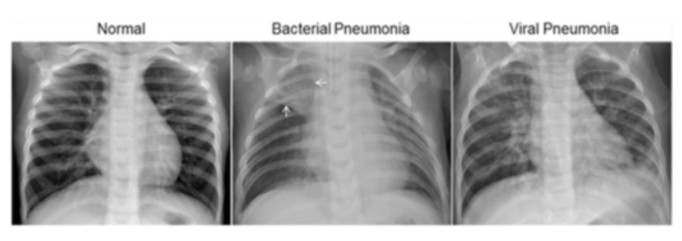
Detection of Pneumonia
with Computer Vision
Problem we are trying to solve
Notes:
Add Training data info

Slide 3
Data Set Details - Key Figures
Organized in 3 folders
(train, test val)
Subfolders for each category
(Pneumonia/ normal)
5,863 X-Ray images
Patients of 1 to 5 years from Guangzhou Hospital
Patients of 1 to 5 years
Low quality images were removed
Images graded by 2 experts before cleared for training

Slide 4
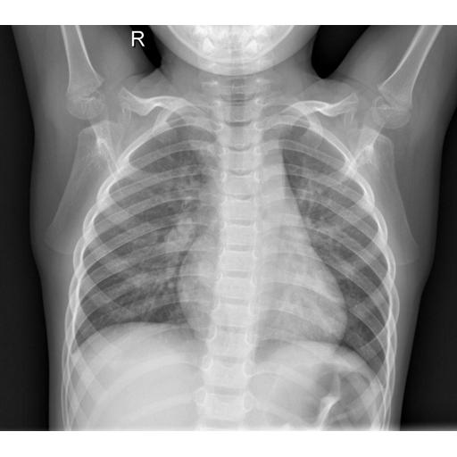
Data Pre- processing and Cleansing
Train, test, val
Convert to
grayscale
Convert 256 x 256 adding padding to preserve aspect ratio
Use Image Data Generator to modify image
Using PIL convert to array
CNN interprets array with 3x3 filter
Notes:
Add Training data info

Slide 5
Preprocessing included images modifications
Adjusted L2 regularization and learning rate improved the overfitting
Removing early stopping improved the strength of the model
Resulting in Accuracy: 80%
Improved by
Model Accuracy
Initial Accuracy: 52%
Notes:
Add Training data info

Slide 6
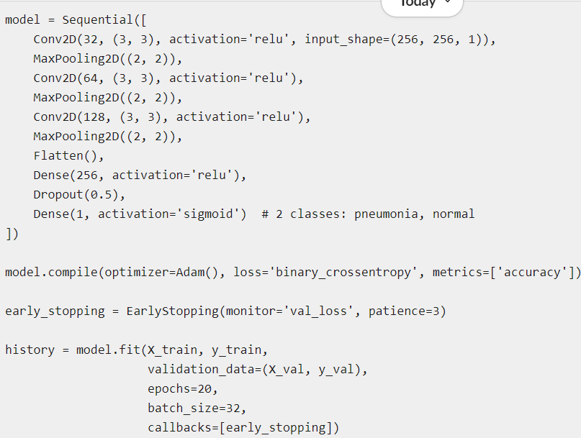
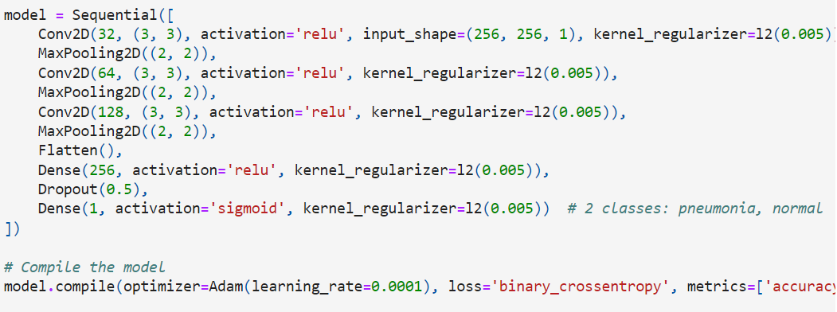
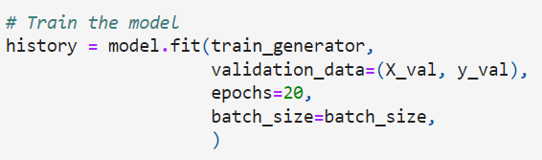
Model Accuracy
Notes:
Spot the difference: l2 regularization, Adam learning rate lowered, X_train images preprocessed, early stopping removed

Slide 7
Findings and Learnings
Modifying the images greatly improved the model, even though they are all X-Rays from the same camera angle it’s a necessary step
Validation set did not include a virus image, need to ensure data received from Kaggle is balanced appropriately
Confusion Matrix:
True Negatives (85): The number of cases correctly identified as not having pneumonia.
False Positives (149): The number of cases incorrectly identified as having pneumonia. This could mean that these individuals might undergo unnecessary further testing or treatment, which could be costly or stressful.
False Negatives (19): The number of cases where the model failed to detect pneumonia even though it was present. This is particularly critical because it represents missed diagnoses, which could delay necessary treatment for affected patients.
True Positives (371): The number of cases correctly identified as having pneumonia. These patients would ideally receive timely treatment.
TN | FP
85 | 149
FN | TP
19 | 371
Notes:
Add Training data info

Slide 8
Future Research
Emphasize the use of multivariable models optimized with grid search techniques
Integrate a human control group into the research for effective benchmarking
Prioritize maximizing the recall metric in model evaluation
Extend the training duration by running the model for more epochs
Notes:
Focus on Multivariable Models with Grid Search:
Utilize models that consider multiple independent variables simultaneously. These models can capture complex relationships and interactions among variables, providing a more comprehensive understanding of the data. Implement grid search to fine-tune hyperparameters of the multivariable models.
Include a Human Control Group in the Research to Benchmark Findings:
Comparing results between the group to helps in understanding the true effect of the intervention by accounting for variables and changes that are independent of the experimental treatment.
This group should ideally match the characteristics of the experimental group, but not undergo the intervention or treatment being studied. helps isolate the true effect of the intervention.
Prioritize the Recall:
Focus on maximizing the recall metric to ensure the model identifies the highest number of relevant cases. Especially important in contexts where missing positive cases (false negatives) can have serious consequences.
Run the Model for More Epochs:
Monitor the model train the model for a higher number of epochs.

